Slide 1

CUAI CV논문리딩스터디 3팀
2022.05.31
발표자 : 정승혁

Slide 2
Fast R-CNN

Slide 3
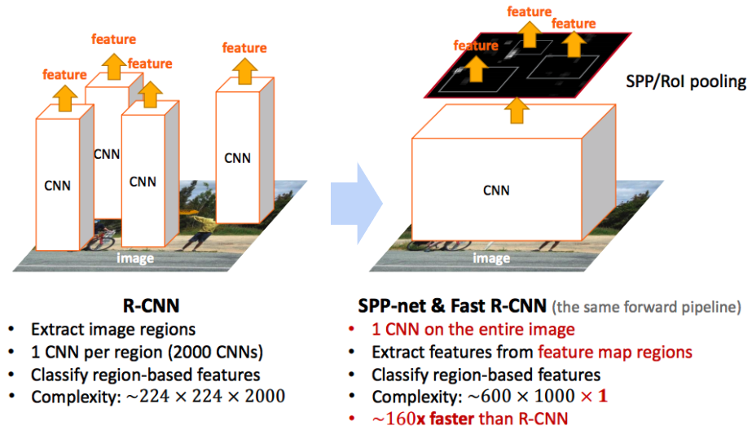
Fast R-CNN

Slide 4
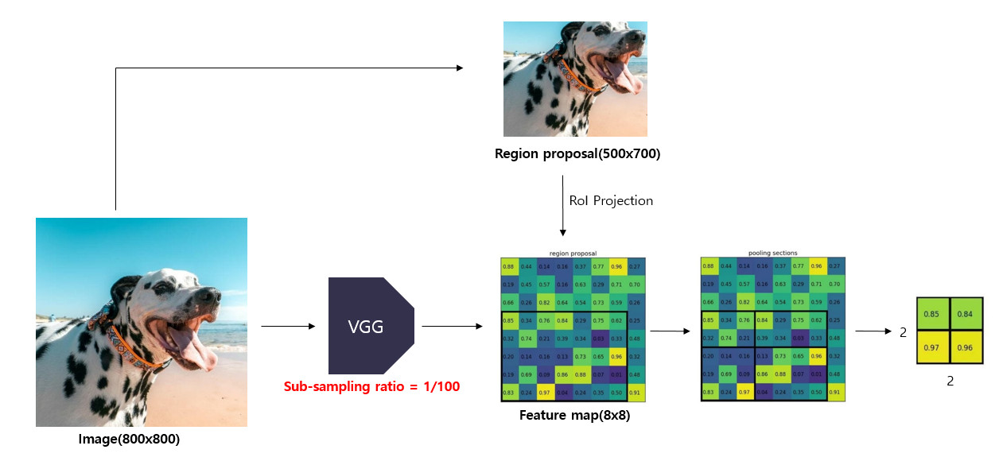
Fast R-CNN
1. Rol(Region of Interest) Pooling

Slide 5

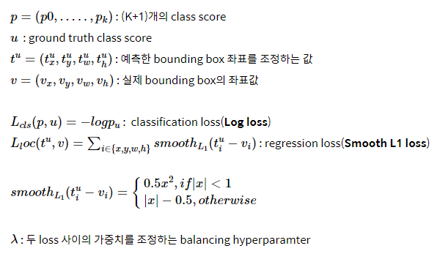
Fast R-CNN
2. Multi-task loss :

Slide 6
Fast R-CNN
3. Hierarchical Sampling
Feature sharing 가능.
SGD mini-batch 구성 시 N개 이미지 sampling, R개의 region proposal 사용
→R/N개의 region proposal sampling
→forward/backward propogation

Slide 7
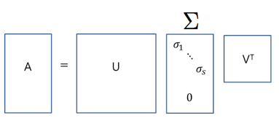
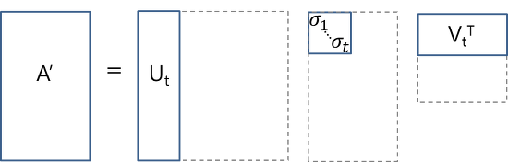
Fast R-CNN
4. Truncated SVD
Full SVD
Truncated SVD

Slide 8
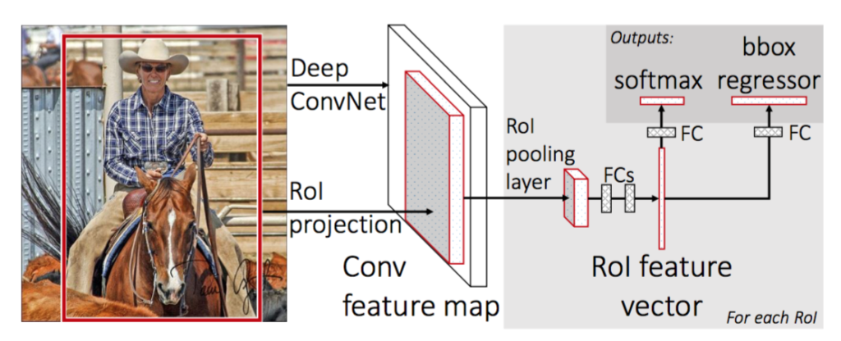
Fast R-CNN – Training architecture

Slide 9
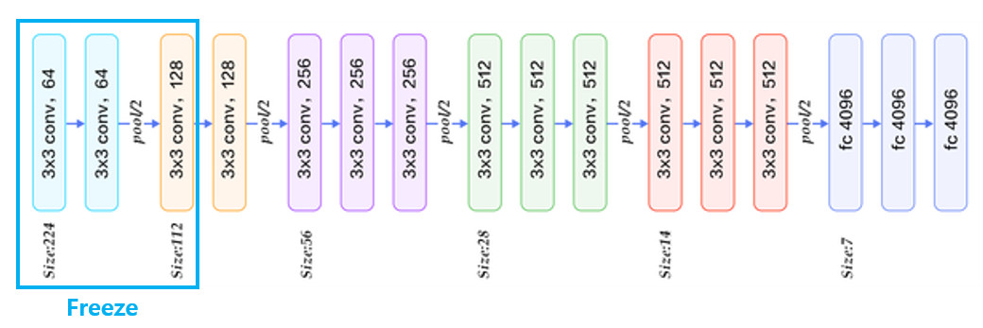
Fast R-CNN – Training architecture
1. Initializing pre-trained network

Slide 10
Fast R-CNN – Training architecture
2. Region proposal by Selective search
Input : image
Process : Selective search
Output : 2000 region proposals

Slide 11
Fast R-CNN – Training architecture
3. Feature extraction(layer 13까지) / VGG16
Input : 224x224x3 image
Process : feature extraction / VGG16
Output : 14x14x512 feature maps

Slide 12
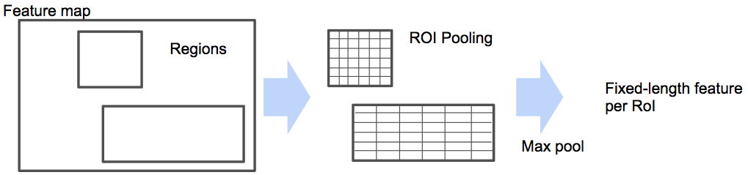
Fast R-CNN – Training architecture
4. Max pooling by Rol pooling
Input : 14x14 sized 512 feature map, 2000 region proposals
Process : Rol pooling
Output : 7x7x512 feature maps

Slide 13
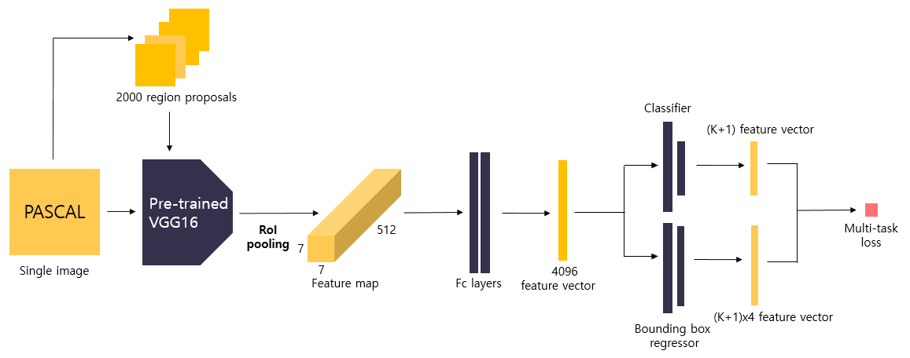
Fast R-CNN – Training architecture
5. Feature vector extraction by FC layers
Input : 7x7x512 feature maps
Process : feature extraction by FC layers
Output : 4096 sized feature vector

Slide 14
Fast R-CNN – Training architecture
6. Class prediction by Classifier
Input : 4096 sized feature vector
Output : (K+1) sized vector(class score)
7. Detailed localization by Bounding box regressor
Input : 4096 sized feature vector
Output : (K+1) x 4 sized vector
8. Train Classifier and Bounding box regressor by multi-task loss
Input : (K+1) sized vector(class score), (K+1) x 4 sized vector
Output : loss(Log loss + Smooth L1 loss)

Slide 15
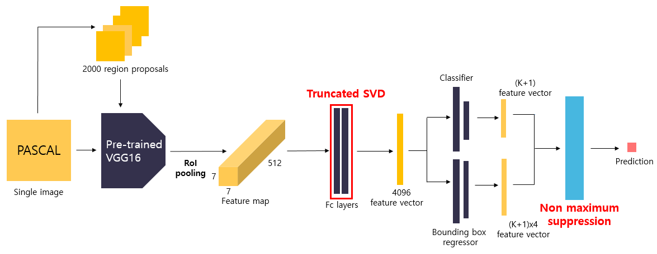
Fast R-CNN – Detection / 특징
R-CNN보다 9배 이상 빠름, detection 시 이미지 당 0.3초 소요

